Slide 1






DATA ANALYTICS PROJECT 2
EFFICIENT UTILIZATION OF TECHNOLOGICAL TOOLS TO ANALYZE ONTARIO PUBLIC LIBRARIES' DATA TO DERIVE INSIGHTS AND IMPROVE THEIR SUCCESS METRICS.
GROUP (4 MEMBERS):
CONFIDENCE IKEMSINACHI AHUEKWE (991714953)
DAVID GICHERU (991665570)
N o v. 2 7 ^{th} , 2 0 2 3 .
IFIOK-OBONG SUNDAY IKPE (991734876)
HENRY NNADOZIE ECHEJI (991730116 )

Slide 2


OBJECTIVE
T O A S S E S S A N D I M P R O V E T H E S U C C E S S M E T R I C S O F O N TA R I O P U B L I C L I B R A R I E S I N C O P I N G W I T H T E C H N O L O G I C A L
A D VA N C E M E N T S .
T O I D E N T I F Y S T R AT E G I E S F O R
E N H A N C I N G R E V E N U E
G E N E R AT I O N , I N C R E A S I N G U S E R E N G A G E M E N T, A N D I M P R O V I N G L I B R A R Y V I S I B I L I T Y.

Slide 3



INTRODUCTION
T h e r a p i d e v o l u t i o n o f t h e i n t e r n e t a n d e m e r g i n g t e c h n o l o g i e s l i k e t h e
I n t e r n e t o f T h i n g s ( I o T ) h a s p r e s e n t e d c h a l l e n g e s f o r O n t a r i o p u b l i c l i b r a r i e s t o a d a p t a n d m a i n t a i n r e l e v a n c e i n
t h e i r s e r v i c e s .
To address these challenges, we had to ask the following questions:
How does the revenue per active cardholder vary across
different types of library services?
Is there a correlation between technological integration and increased revenue?
How can libraries leverage IoT environments to improve
services and user engagement?

Slide 4

SUCCESS CRITERIA
FIRST | SECOND | THIRD | FOURTH
Increased revenue generation per active cardholder. | Enhanced social media visibility. | Higher borrowing rates or increased cardholder numbers. | Improved service utilization metrics.

Slide 5
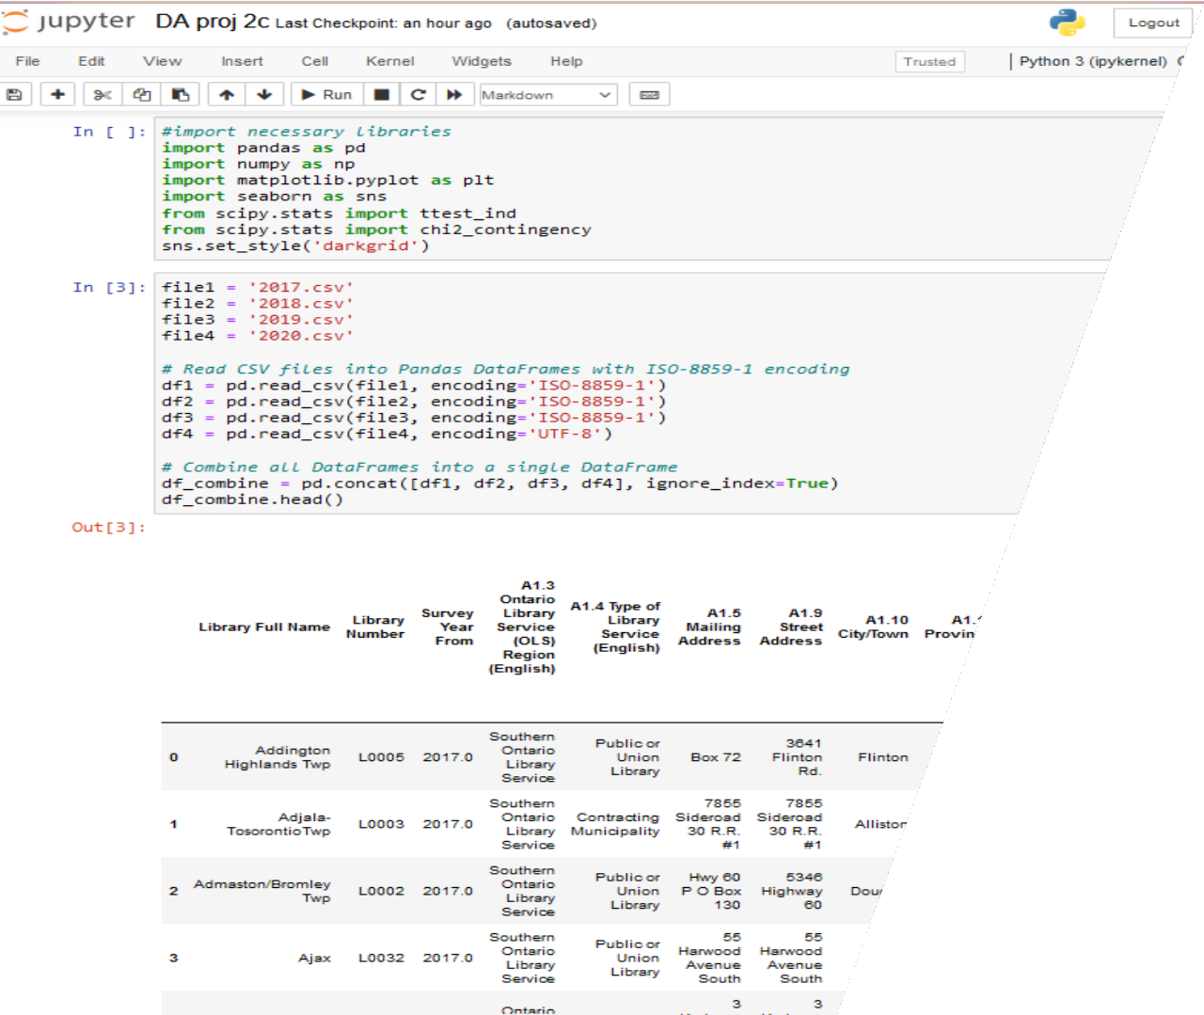

A N A L Y S I S P L A N
L O A D I N G A N D F I LT E R I N G :
L O A D T H E C O M B I N E D D ATA S E T.
F I LT E R D ATA F O R R E L E VA N T C O L U M N S A N D Y E A R S .
P R E P R O C E S S I N G A N D C L E A N S I N G :
M E R G E D ATA S E T S F R O M 2 0 1 7 - 2 0 2 0 , H A N D L E M I S S I N G D ATA , A N D S TA N D A R D I Z E F O R M AT S .
P E R F O R M O U T L I E R A N A LY S I S T O I D E N T I F Y A N O M A L I E S I N R E V E N U E , C A R D H O L D E R
N U M B E R S , E T C .

Slide 6

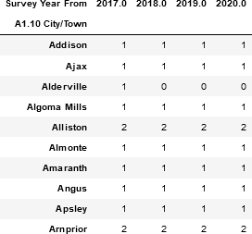
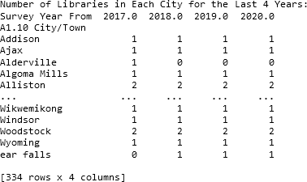
TA B L E T H AT L I S T S T H E N U M B E R O F L I B R A R I E S I N E A C H C I T Y F O R T H E L A S T 4 Y E A R S .

Slide 7

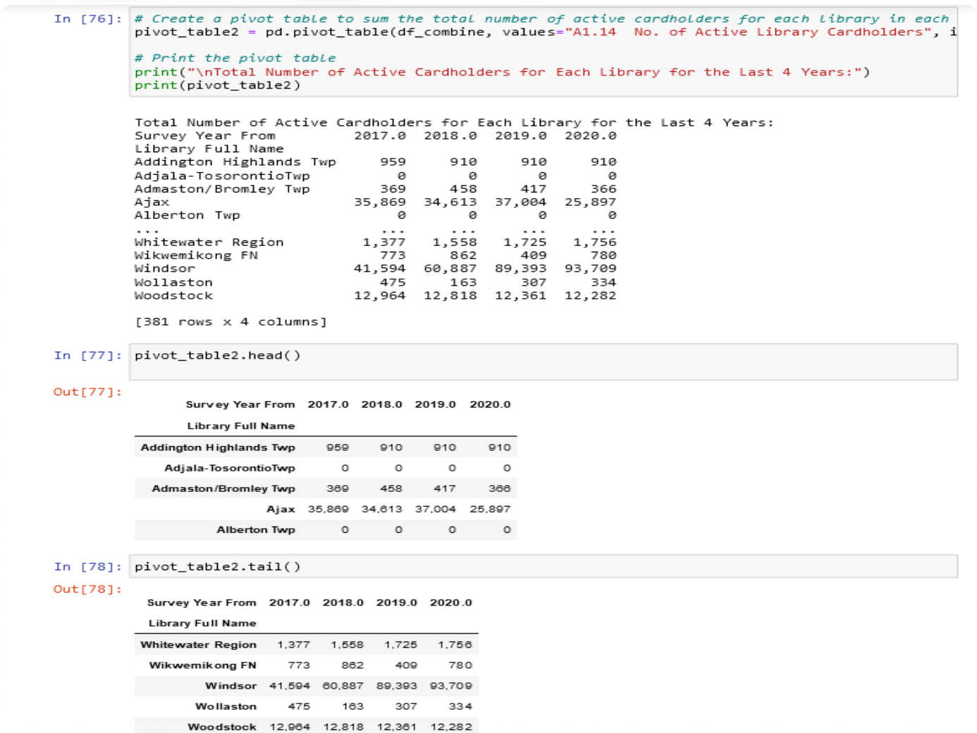

CO DE T H AT S H OWS T H E TOTA L N UM B E R O F
AC T I V E CA RDH O L DE RS FO R EACH L I B RA RY FO R T H E L A ST 4 Y EA RS
.
7

Slide 8




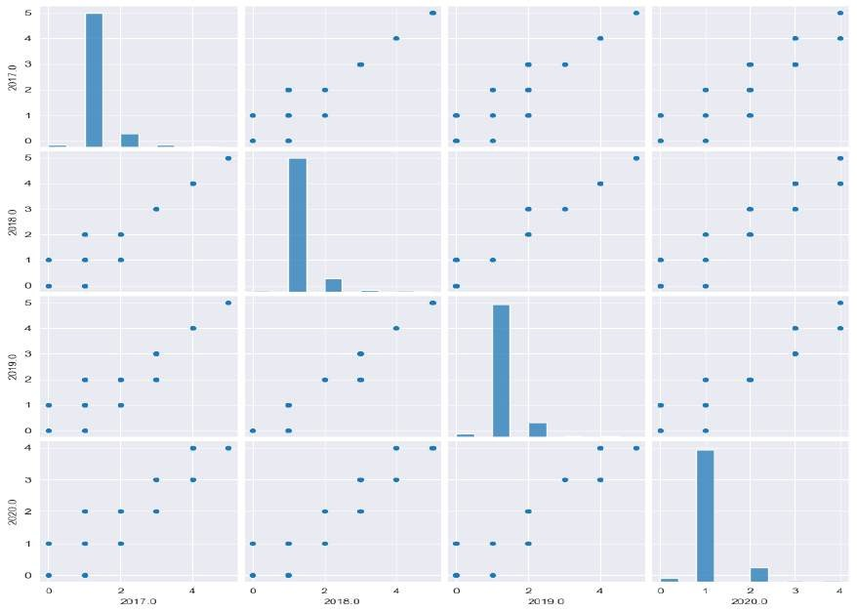

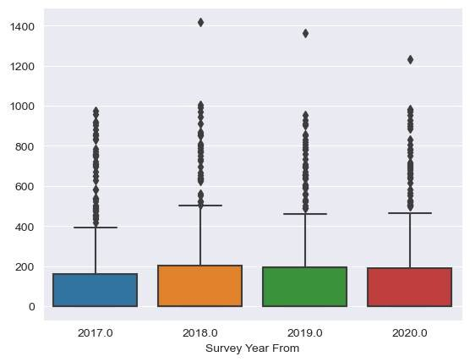
8

Slide 9




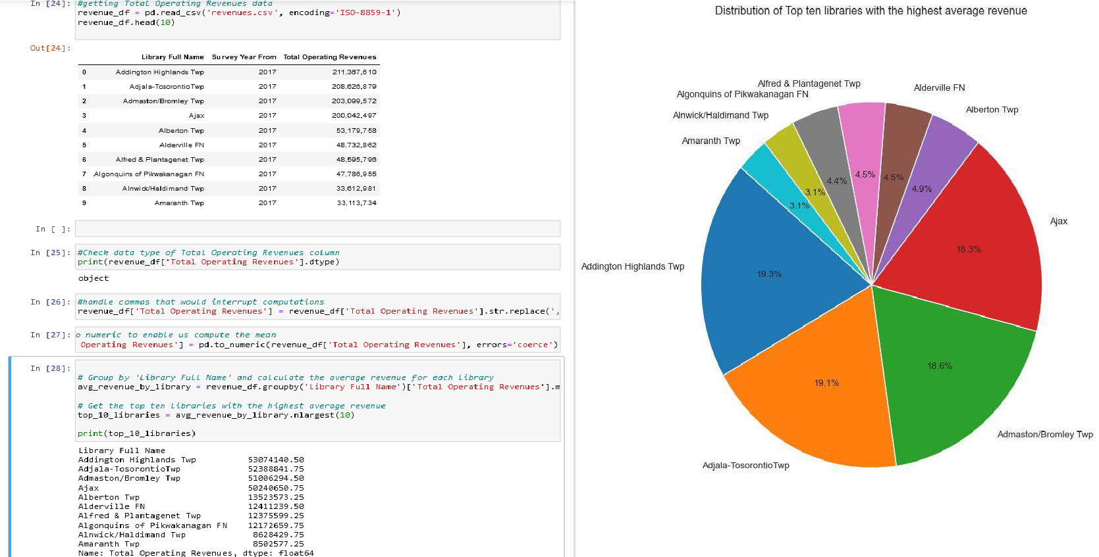
8

Slide 10
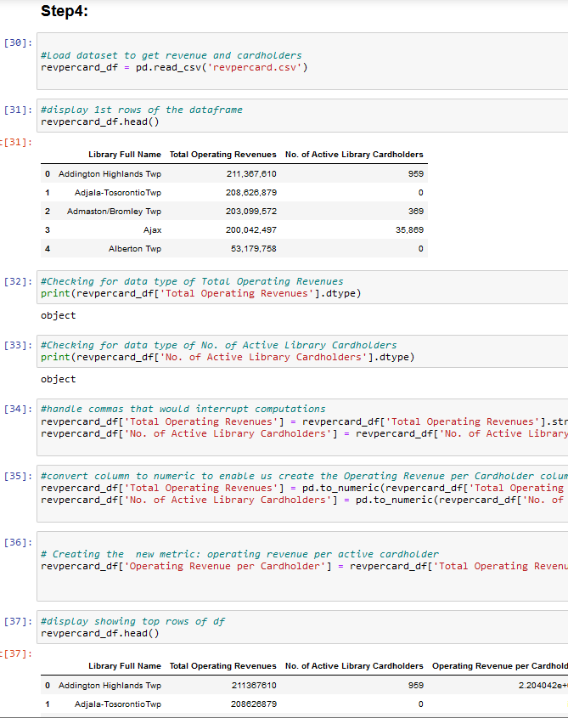
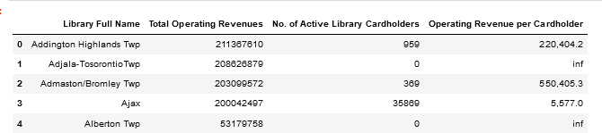
Ontario (E.g: operating revenue per active card holder).
Creating a new metric (column) to compare libraries across
CODE RESULT
10

Slide 11
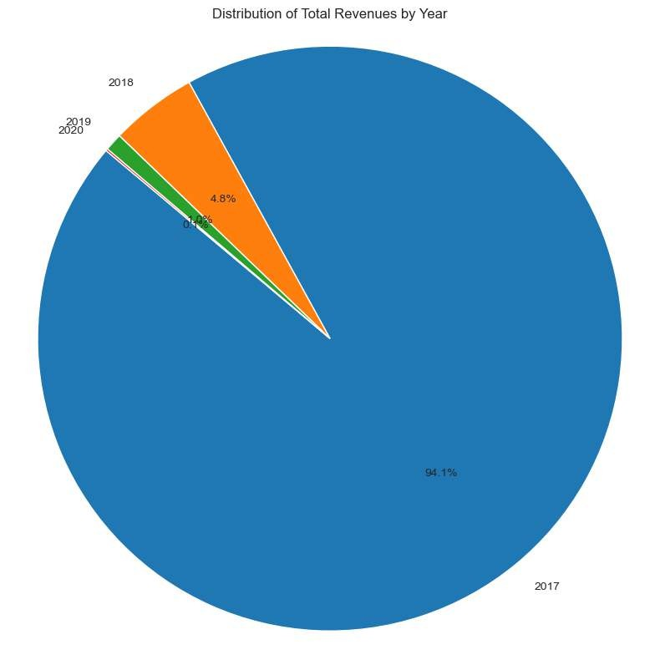
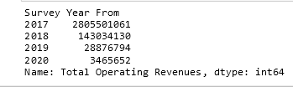

CONCLUSION
Addington Highlands Twp is the library with the highest average revenue over the four year period (2017 – 2020) having 19.3% of the Top ten libraries and 53074140.50 average revenue.
From the pie chart we can observe that 2017 was the year with the highest operating revenue with 94.1%, while 2020 generated the least amount of revenue with 0.1%.
Insights from other data visualization suggests that there is a weak negative correlation between the number of active cardholders and the operating revenue per cardholder, meaning that as the number of active cardholders increases, the operating revenue per cardholder decreases.
11

Slide 12



Q U E S T I O N S ?

